Slide 1
DYNAMIC PROGRAMMING dp
DESIGN AND ANALYSIS OF ALGORITHMS
LECTURER: Nguyễn Thanh Sơn
CS112.L23.KHCL.N12

Slide 2
The shortest path
4
A D
1
11
18
9
2
5
13
S
B
E
T
16
2
5
C F
2
Apply the Greedy approach, the shortest path from S to T is?

Slide 3
The shortest path
The Greedy approach can not be applied to this case:
(S, A, D, T) 1+4+18=23
The real shortest path is:
(S, C, F, T) 5+2+2=9
So today we will learn about a new algorithm

Slide 4
CONTENT
What is Dynamic Programming?
Characteristics of Dynamic Programming
Dynamic Programming Methods
Compare with other algorithms
Steps in Dynamic Programming

Slide 5
1. What is Dynamic programMing?
Dynamic programming (DP) approach is similar to Divide and Conquer in breaking down the problem in smaller and yet smaller possible sub-problems.
But unlike Divide and Conquer, results of these smaller sub-problems are remembered and used for similar or overlapping sub-problems.

Slide 6
2. Characteristics of Dynamic Programming
Overlapping Subproblems
Optimal Substructure

Slide 7
Overlapping Subproblems
There exist some places where we solve the same subproblem more than once

Slide 8

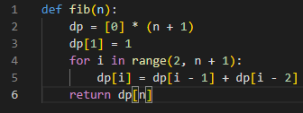
EX:
DP:

Slide 9
Optimal Substructure
The optimal solution to the problem contains within optimal solutions to its subproblems.

Slide 10
EX:
3
2
7
1
4
S
A
B
T
5
5
6
d_{min} (S, T) =
d_{min}(S, A) + d_{min}(A, B) + d_{min}(B, T)
= 1 + 2 + 5
= 8
Dijkstra

Slide 11
3. Dynamic Programming Methods
DP offers two methods to solve a problem:
Top-down with Memoization
Bottom-up with Tabulation

Slide 12
3. Dynamic Programming Methods
Top-down with Memoization
MemoRization
f5
In this approach, we try to solve the bigger problem by recursively finding the solution to smaller sub-problems. Whenever we solve a sub-problem, we cache its result so that we don’t end up solving it repeatedly if it’s called multiple times. Instead, we can just return the saved result. This technique of storing the results of already solved subproblems is called Memoization.
f3
f4
f1
f2
f2
f3
f0
f1
f0
f1
f2
f1
f0
f1

Slide 13
3. Dynamic Programming Methods
Top-down with Memoization
f5
F=[]
def Fib(n):
if n in F:
return F[n]
if (n < 2):
return 1
result = Fib(n-2) + Fib(n-1)
F[n] = result
return result
f3
O(n)
f4
f1
f2
f2
f3
f0
f1
f0
f1
f2
f1
f0
f1

Slide 14
3. Dynamic Programming Methods
Bottom-up with Tabulation
f5
Tabulation is the opposite of the top-down approach and avoids recursion. In this approach, we solve the problem “bottom-up” (i.e. by solving all the related sub-problems first). This is typically done by filling up an n-dimensional table. Based on the results in the table, the solution to the top/original problem is then computed.
f3
f4
f1
f2
f2
f3
f0
f1
f0
f1
f2
f1
f0
f1

Slide 15
3. Dynamic Programming Methods
Bottom-up with Tabulation
f5
def Fib(n):
F[0] = 0
F[1] = 1
for i in 2...n
F[i] = F[i-2] + F[i-1]
return F[n]
O(n)
f3
f4
f1
f2
f2
f3
f0
f1
f0
f1
f2
f1
f0
f1

Slide 16
Comparison
Top-down with Memoization | Bottom-up with Tabulation
Easy to set up | Gets complicated if there are multiple conditions
Must be solved from the top down | Must be solved from the bottom up
Slower due to recursion | Faster, due to direct access to the results stored in the table
Just solve the necessary problems | Must solve all subproblems

Slide 17
4. Compare with other algorithms
Dynamic programming | Greedy approach
DP are motivated for an overall optimization of the problem | Local optimization is addressed

Slide 18
4. Compare with other algorithms
Dynamic Programming | Divide and Conquer
DP use the output of a smaller sub-problem and then try to optimize a bigger sub-problem and use Memoization to remember the output of already solved sub-problems. | Solutions are combined to achieve an overall solution

Slide 19
Dynamic Programming
Paradigm
Methodology
Overlapping Subproblems
Memoization
Top-down approach
Divide and Conquer
AND
OR
Optimal Substructure
Tabulation
Bottom-up approach

Slide 20
5. Steps in Dynamic Programming
Characterize structure of an optimal solution.
Define value of optimal solution recursively.
Compute optimal solution values either top-down with caching or bottom-up in a table.
Construct an optimal solution from computed values.

Slide 21
KAHOOT!

Slide 22
HOMEWORK
Gmail: 19521482@gm.uit.edu.vn
Deadline: 11h59 PM, 30/05/2021

Slide 23
The shortest path
4
A D
1
11
18
9
2
5
13
S
B
E
T
16
2
5
C F
2
Apply the Dynamic programming, the shortest path from S to T is?

Slide 24
thanks!
Any questions?
You can review these slides on our team's GitHub

Slide 25
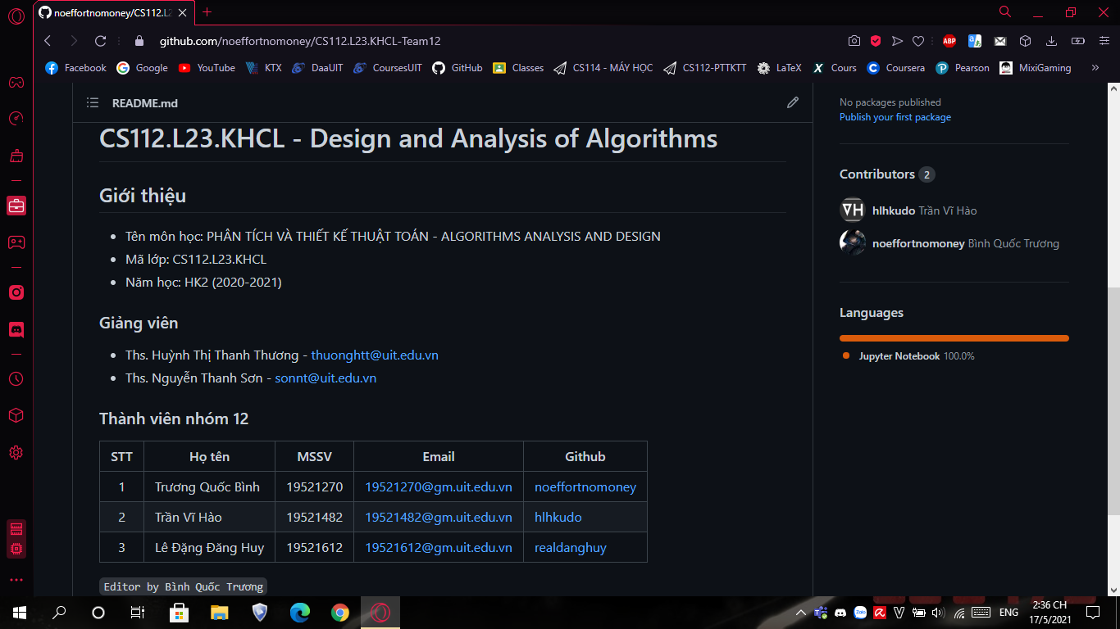
Place your screenshot here
Our team’s github link:
https://github.com/noeffortnomoney/CS112.L23.KHCL-Team12

Slide 26
Credits
Special thanks to all the people who made and released these awesome resources for free:
Presentation template by SlidesCarnival
TOPDev.vn
educative.io
tutorialspoint.com
geeksforgeeks.org
gacsach.vn
Some PowerPoint files in the Reference section (GitHub)

